Slide 1

A SECURE NETWORK
FOR ACME
TEAM OMEGA
Fredrik Krantz
Xin Liu
Ruizhi Yang

Slide 2
3 Subnets
Part I
Secure Servers
Network
Topology

Slide 3
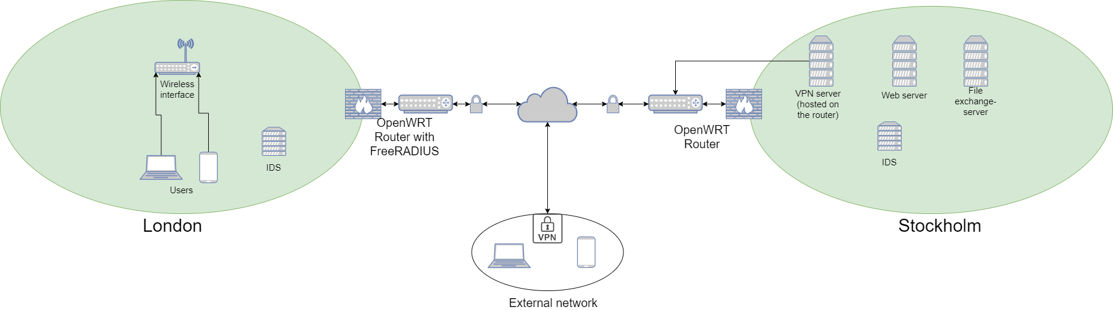
Network Topology
Notes:
其在计算机视觉、自然语言处理、语音识别等各种领域都取得了较大的发展，并且得到了一定的研究成果与应用。随着深度学习的快速发展，在近年来开始运用到通信系统中，进行通信智能系统的搭建。
通信系统的传统模块框架也开始有研究尝试用自编码器深度学习技术进行重构，将通信系统作为一个端到端的信号重构问题进行全局优化，进行端到端的智能化通信系统构建的尝试。

Slide 4
VPN
Part II
2FA
External Security

Slide 5
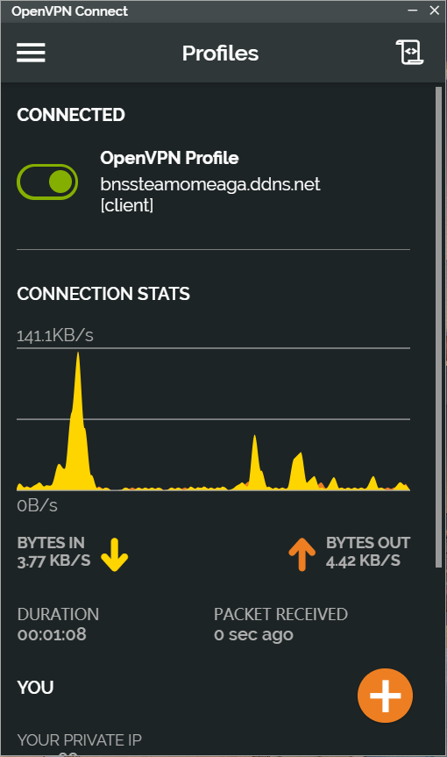
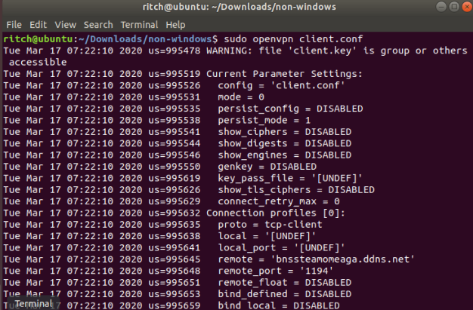
External Security--VPN
We configured the Stockholm router as the VPN server.
The tool we used here is OpenVPN.
Employees only need to install OpenVPN on their devices, and use the configure file in order to use it to connect to Stockholm network.
OpenVPN on Ubuntu
OpenVPN on windows
Notes:
自编码（Autoencoder），又称自编码器,是一种使用无监督学习的人工神经网络（ANN），使用了反向传播算法，使得系统输出等于输入，主要分为两个部分：编码与解码。

Slide 6
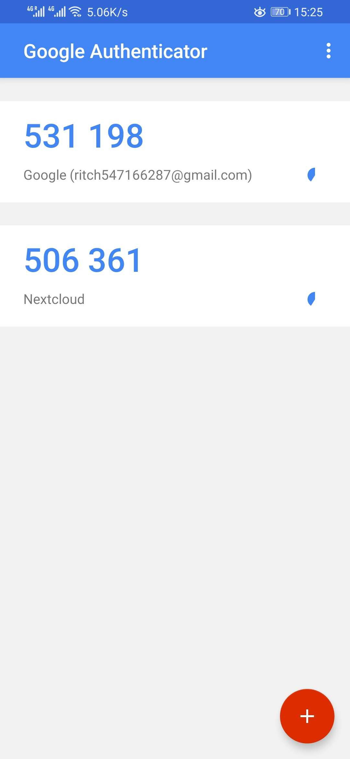
External Security--2FA
To access the secure data of the web server, users should be authenticated using two factors(2FA).
An employee is required to install their ACME certificate on devices they use to access the server.
The second factor is an one-time 6-digit pin-codes(OTP). We used Google Authenticator to achieve this, which is based on TOTP and should be install on user's mobile devices.
Its pin-codes will be refreshed every 30 seconds.
Google Authenticator
Notes:
自编码（Autoencoder），又称自编码器,是一种使用无监督学习的人工神经网络（ANN），使用了反向传播算法，使得系统输出等于输入，主要分为两个部分：编码与解码。

Slide 7
Web server
Part III
Wireless Security
Internal Security
&
File Exchange
IDS
File Exchange

Slide 8
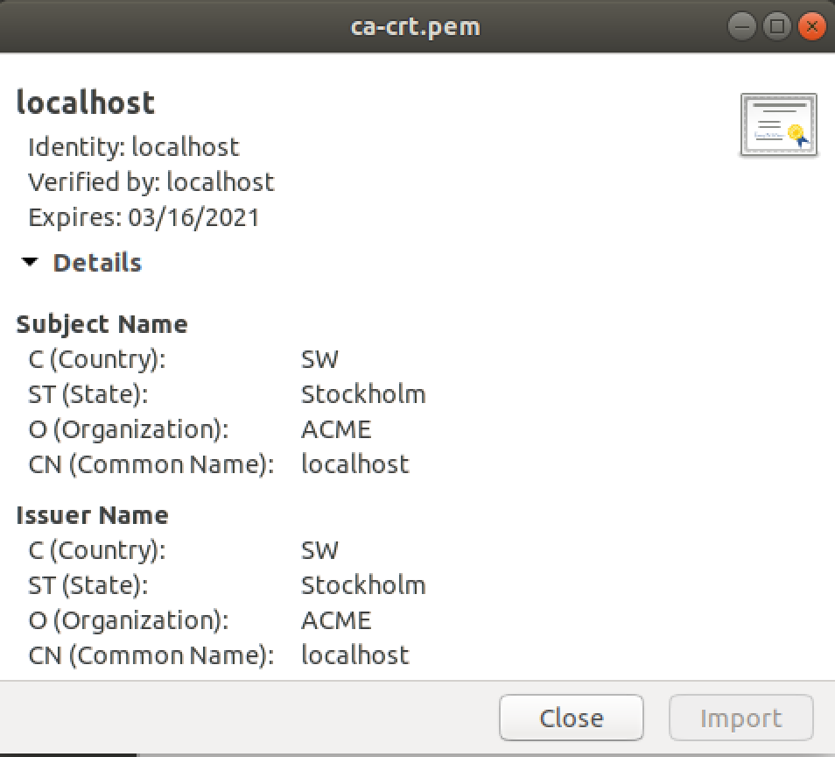
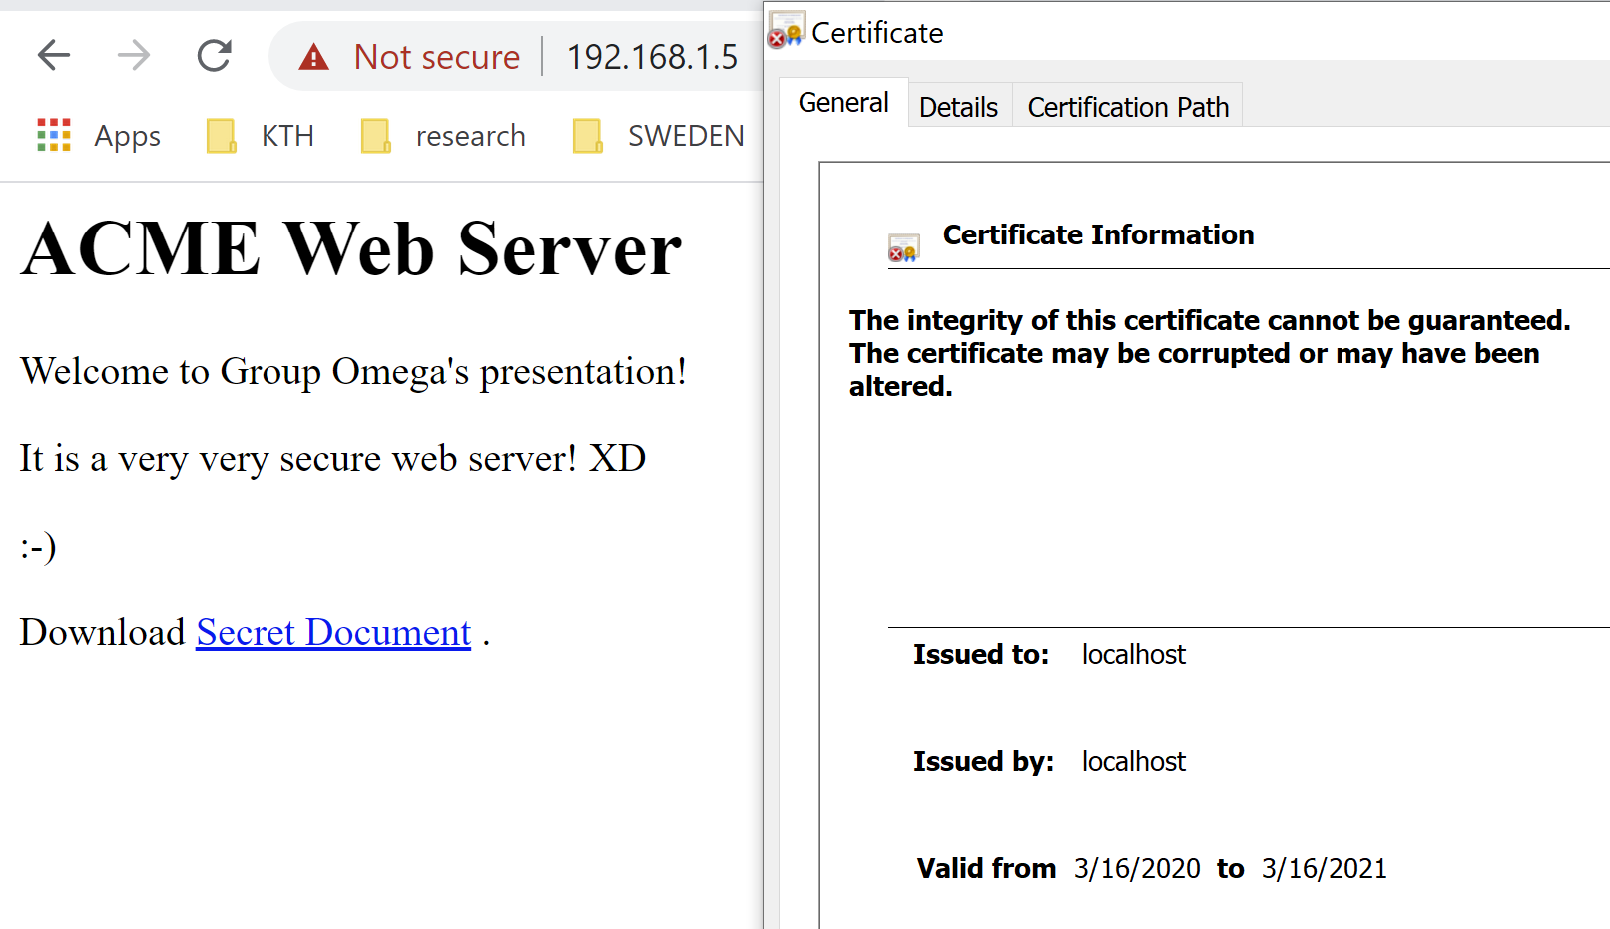
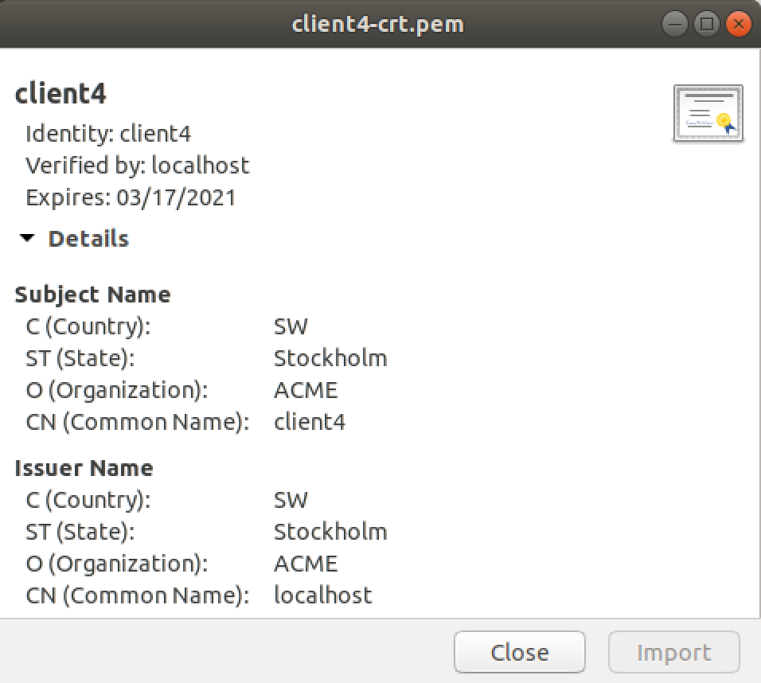
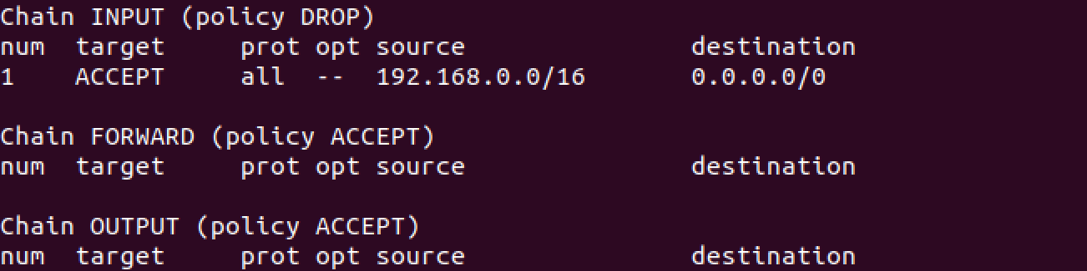
Internal Security—Web Server ( Firewall & Certificate )
We use Apache for setting our web server.
We force https using and use mutual authentication for the web server. Both of the server and the users should verify each other’s certificates. And the tool we use here is OpenSSL.
We configure the firewall using Iptables. We only accept the access of Stockholm network.
Notes:
对于神经网络构建可以采用Tensorflow库来完成相关工作。而在仿真中可以使用光仿真软件Optisystem来完成，且该软件具有MATLAB接口，可以与MATLAB进行协调操作。

Slide 9
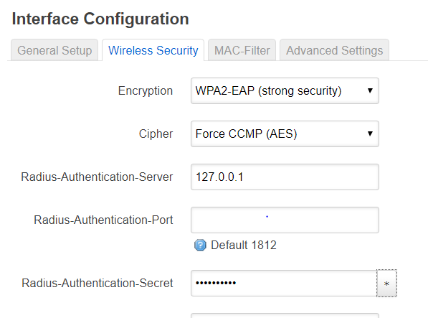
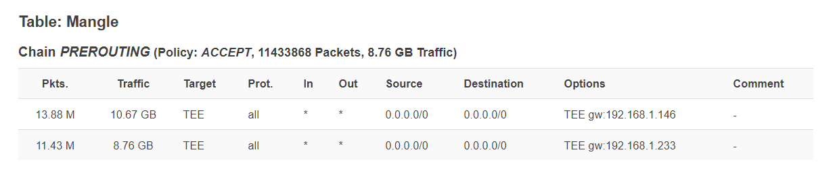
Internal Security—Wireless security and IDS
Freeradius for authorizing wireless access in London
Easy to setup with openwrt
Snort as an NIDS, with mirrored traffic from router to get more coverage

Slide 10
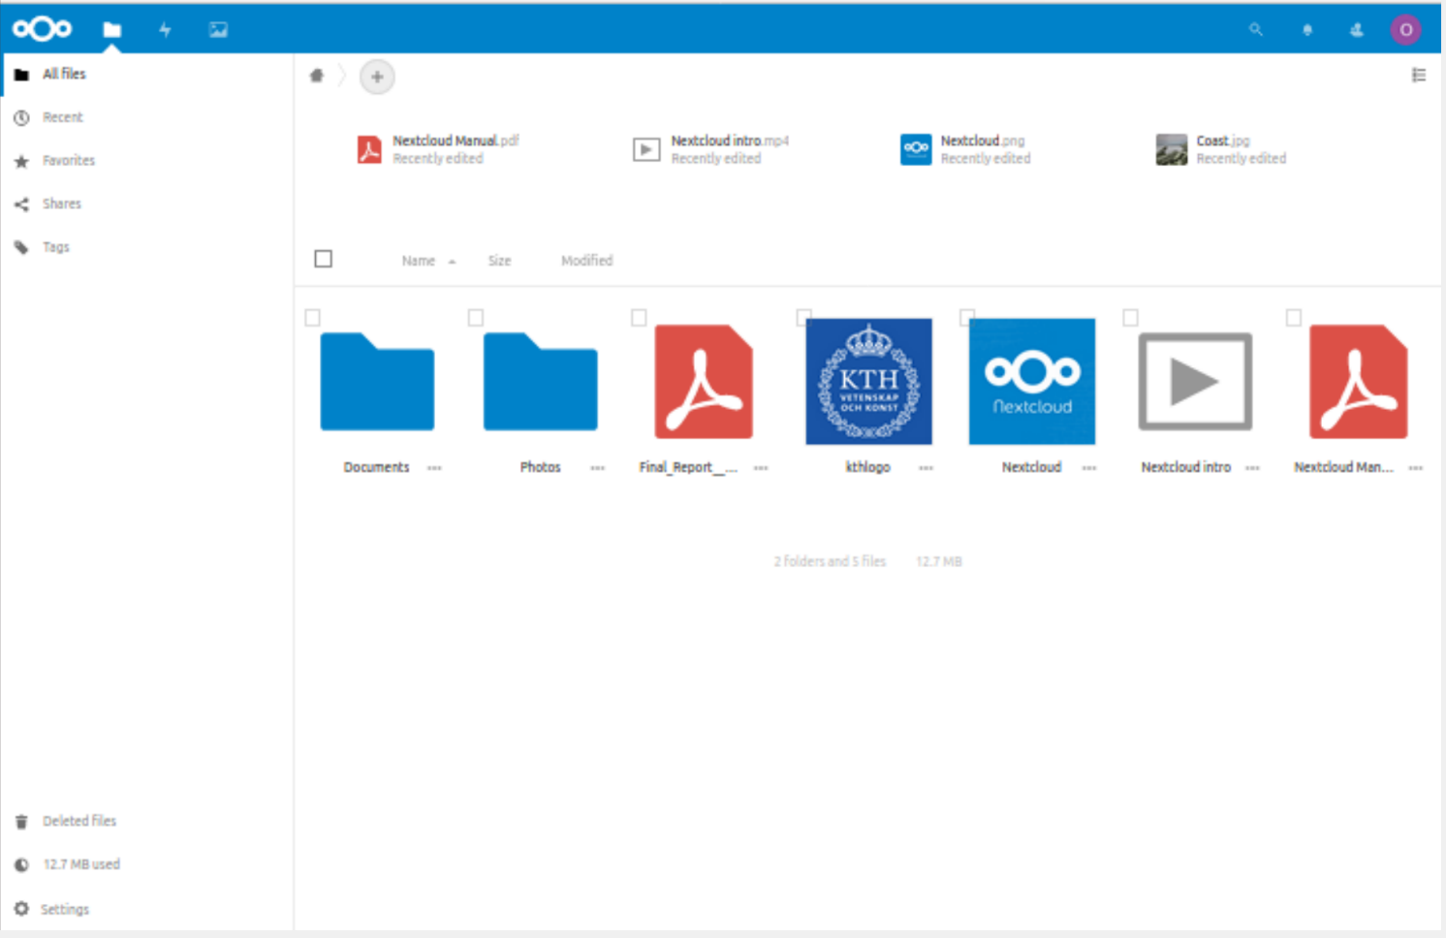
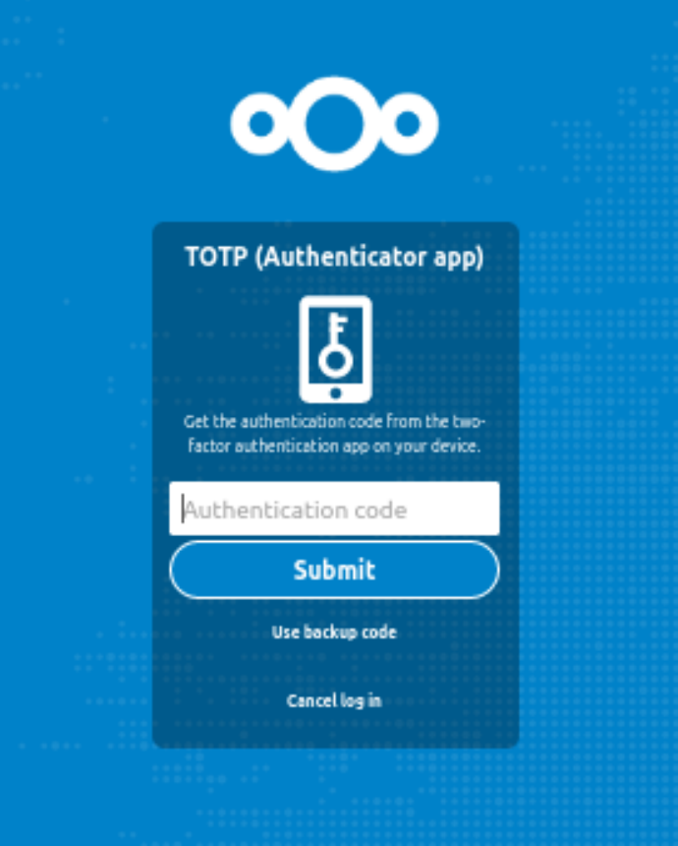
File Exchange--Nextcloud
We use Nextcloud for our file exchange.
Easy access
Ultimate security
Deep integration
We enable the TOTP app for two-factor authentication.
Notes:
对于神经网络构建可以采用Tensorflow库来完成相关工作。而在仿真中可以使用光仿真软件Optisystem来完成，且该软件具有MATLAB接口，可以与MATLAB进行协调操作。

Slide 11
Thanks for watching
Ruizhi Yang
Xin Liu
Fredrik Krantz

